Slide 1
Amazon Best Seller Data Trends
Analyzing Product Rankings and Market Insights

Slide 2
Table of Contents
Introduction to Best Seller Data
Sources and Data Types
Key Metrics and Indicators
Analysis Techniques
Business Use Cases
Consideration

Slide 3

Importance of Best Seller Lists
Understanding Amazon Best Seller Data
Amazon updates its best seller publications rankings yearly, providing real-time visibility into the most popular publications in each genre. This data helps authors and publications track shifting market demand, identify trending items, and benchmark category leaders. Analysts reviews on best seller data to understand consumer preferences and forecast retail performance.
Name | Author | User Rating | Reviews | Price | Year | Genre
10-Day Green Smoothie Cleanse | JJ Smith | 4.7 | 17350 | 8 | 2016 | Non Fiction
11/22/63: A Novel | Stephen King | 4.6 | 2052 | 22 | 2011 | Fiction
12 Rules for Life: An Antidote to Chaos | Jordan B. Peterson | 4.7 | 18979 | 15 | 2018 | Non Fiction
1984 (Signet Classics) | George Orwell | 4.7 | 21424 | 6 | 2017 | Fiction
5,000 Awesome Facts (About Everything!) (National Geographic Kids) | National Geographic Kids | 4.8 | 7665 | 12 | 2019 | Non Fiction

Slide 4
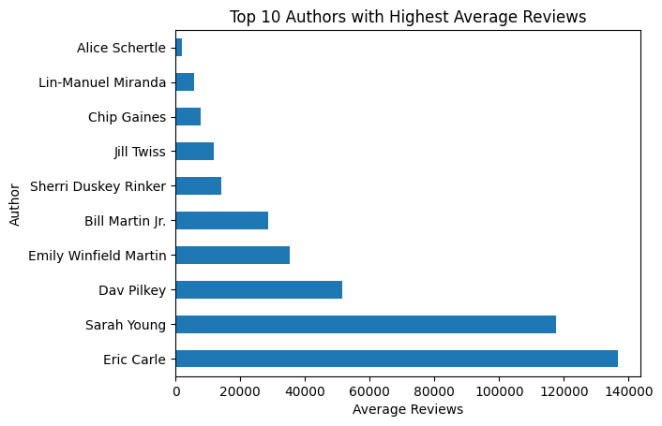
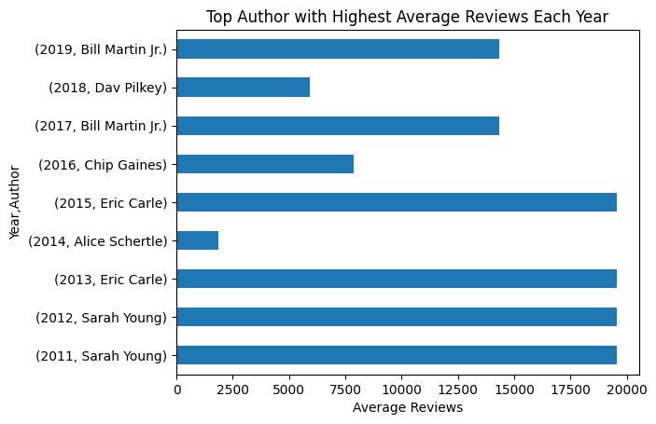
Amazon Best Seller Data Author review Overview
Segmented best seller data provides actionable insights for Author, price, and genre.
1. Top reviewed Author in top and ratings and reviews
1. Top reviewed Author in top reviews every year
[[[[
[[[[
Amazon best seller rankings highlight for top 10 Authors with most reviews and top ratings in every years on the data
Amazon best seller rankings highlight for top 10 Authors with most reviews and top ratings in all over the years on the data

Slide 5
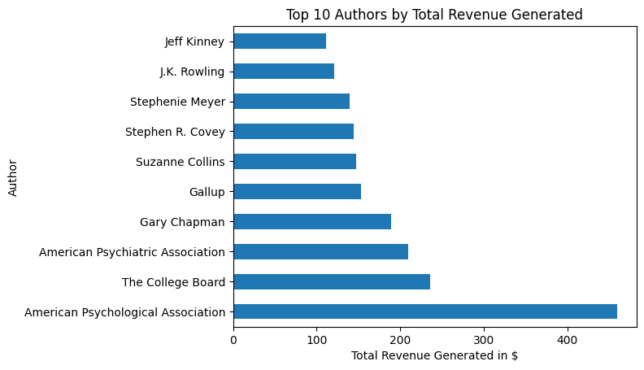
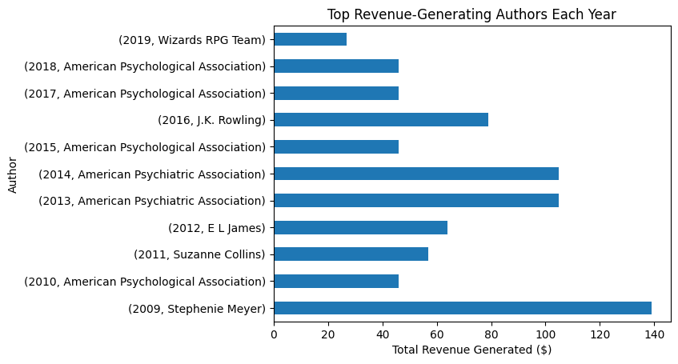
Amazon Best Seller Data authors Overview
Segmented best seller data provides actionable insights for Author, price, and genre.
2. Top revenue generated authors
3. Top revenue generated authors for every years
[[[[
[[[[
Amazon best seller rankings highlight for top 10 revenue generated Authors in $ for every years on the data
Amazon best seller rankings highlight for top 10 revenue generated Authors in $ for all over the years on the data

Slide 6
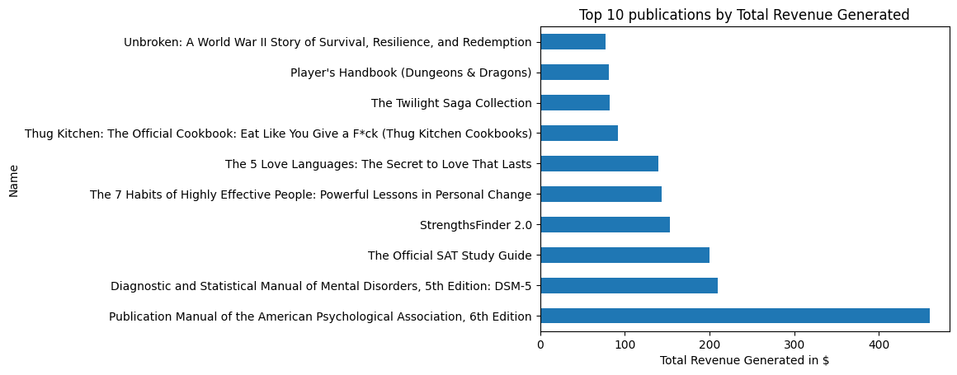
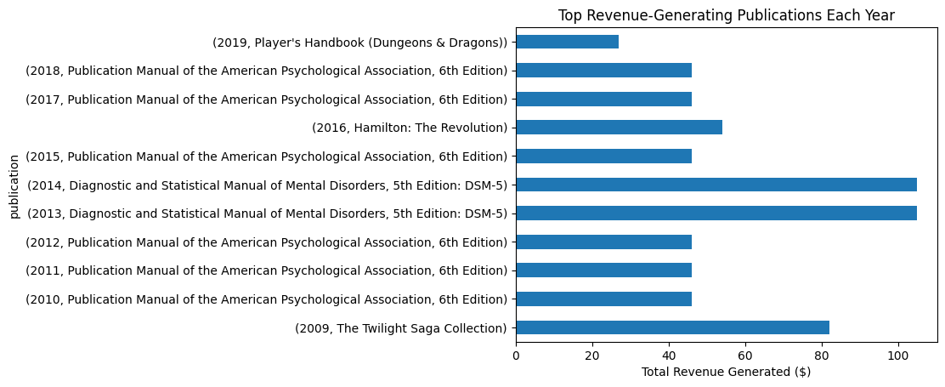
Amazon Best Seller Data publications Overview
Segmented best seller data provides actionable insights for Author, price, and genre.
4. Top revenue generated publications overrall
5. Top revenue generated publications for every years
[[[[
[[[[
Amazon best seller rankings highlight for top 10 revenue generated publications in $ for every years on the data
Amazon best seller rankings highlight for top 10 revenue generated publications in $ for all over the years on the data

Slide 7
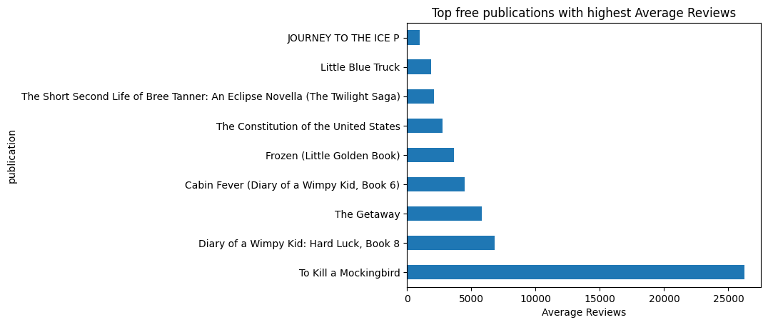
Amazon Best Seller Data Free publications Overview
Segmented best seller data provides actionable insights for Author, price, and genre.
6. Top free publications with high rating and reviews
[[[[
Amazon best seller rankings highlight for top 10 free publications with high average ratings & reviews all over the years

Slide 8
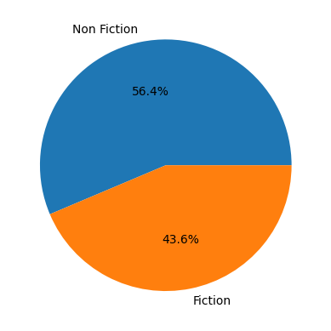
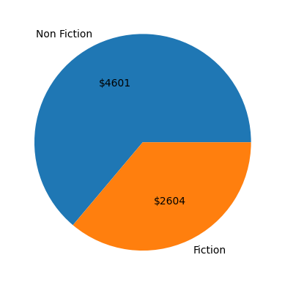
Amazon Best Seller Data Overview
Segmented best seller data provides actionable insights for Author, price, and genre.
7. Genre separations of the data
7. Genre separations of the data
[[[[
[[[[
Volume of Fiction and Non Fiction genre
Revenue of Fiction and Non Fiction genre

Slide 9
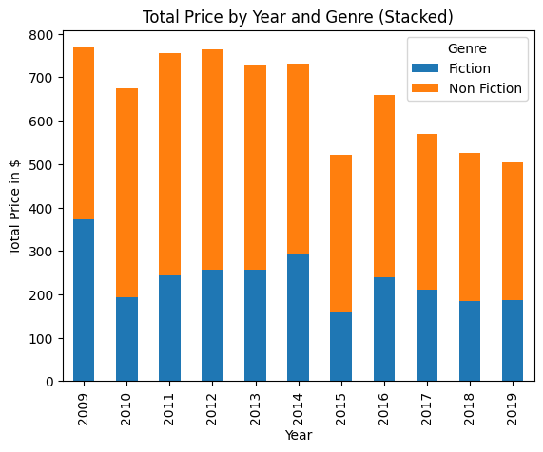
Amazon Best Seller Data Overview
Segmented best seller data provides actionable insights for Author, price, and genre.
8. Comparing Genre separations of the data every year
[[[[
Volume of Fiction and Non Fiction genre publications had compared and featured on histogram with stacked data over it with years of sellers data
When compared with both genres the non -fiction had publications had more revenue every year on the data

Slide 10
Use Cases and Business Insights
Best seller data reveals actionable insights for inventory, product strategy, market entry, and real
Genre planning
Authors
From the analysis on the genre overview we may take decision through the insights
Consider non-Fiction publications over Fiction in terms of sales, revenue and usages
Monitoring yearly growth and difference in genres may help to co ordinate the sales through it
Around 248 unique Authors we have analyzed the top revenue generated and reviewed Authors on the data
On the terms of review “Eric carle” had highest reviews among others
On the terms of revenue “American Psychological association ” had highest revenue among others
GENRE
AUTHORS
Publications devolpment
Free Publications
PUBLICATIONS
Free Publications
Around 351 unique publications we have analyzed the top selling publications on the data
The top selling publication named “Publication Manual of the American Psychological association 6th edition” when comparing to all others
Every year Top revenued publications are shown for the business desicions
There are few free publications on the data and had top free publications with highest reviews as considered
“To Kill a Mockingbird” had most reviews on among Free publications
Strategic Use

Slide 11
Thank You

